Slide 1
Section R.3
Geometry Essentials
Copyright © 2012 Pearson Education, Inc. Publishing as Prentice Hall.

Slide 2
Copyright © 2012 Pearson Education, Inc. Publishing as Prentice Hall.

Slide 3
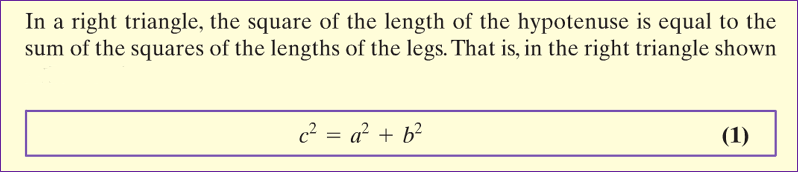
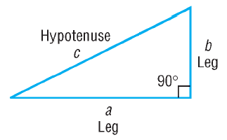
Copyright © 2012 Pearson Education, Inc. Publishing as Prentice Hall.

Slide 4



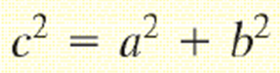
In a right triangle, one leg is of length 4 and the other is of length 3. What is the length of the hypotenuse?
Copyright © 2012 Pearson Education, Inc. Publishing as Prentice Hall.

Slide 5

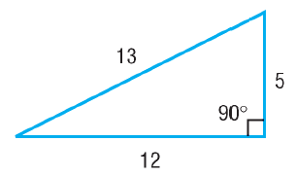
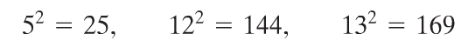
Converse of the Pythagorean Theorem
Show that a triangle whose sides are of lengths 5, 12, and 13 is a right triangle. Identify the hypotenuse.
Copyright © 2012 Pearson Education, Inc. Publishing as Prentice Hall.

Slide 6
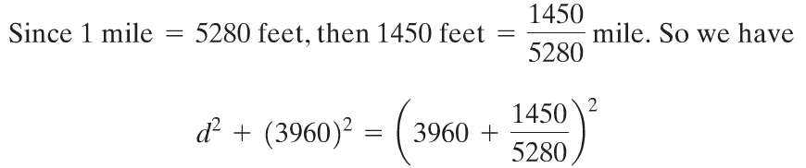

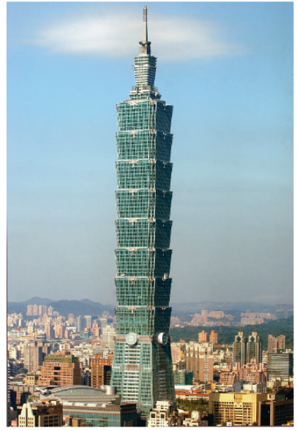
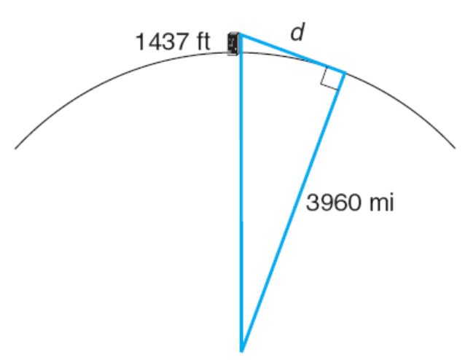

Excluding antenna, the tallest inhabited building in the world is Taipei 101 in Taipei, Taiwan. If the indoor observation deck is 1437 feet above ground level, how far can a person standing on the observation deck see (with the aid of a telescope)? Use 3960 miles for the radius of Earth.
Copyright © 2012 Pearson Education, Inc. Publishing as Prentice Hall.

Slide 7

Copyright © 2012 Pearson Education, Inc. Publishing as Prentice Hall.

Slide 8
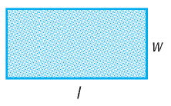
Copyright © 2012 Pearson Education, Inc. Publishing as Prentice Hall.

Slide 9

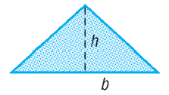
Copyright © 2012 Pearson Education, Inc. Publishing as Prentice Hall.

Slide 10

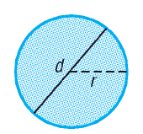
Copyright © 2012 Pearson Education, Inc. Publishing as Prentice Hall.

Slide 11
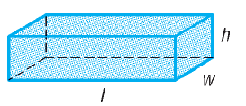
Copyright © 2012 Pearson Education, Inc. Publishing as Prentice Hall.

Slide 12


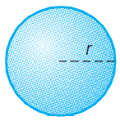
Copyright © 2012 Pearson Education, Inc. Publishing as Prentice Hall.

Slide 13
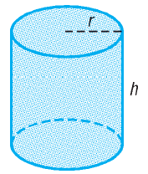
Copyright © 2012 Pearson Education, Inc. Publishing as Prentice Hall.

Slide 14

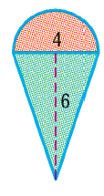


Copyright © 2012 Pearson Education, Inc. Publishing as Prentice Hall.

Slide 15
Copyright © 2012 Pearson Education, Inc. Publishing as Prentice Hall.

Slide 16

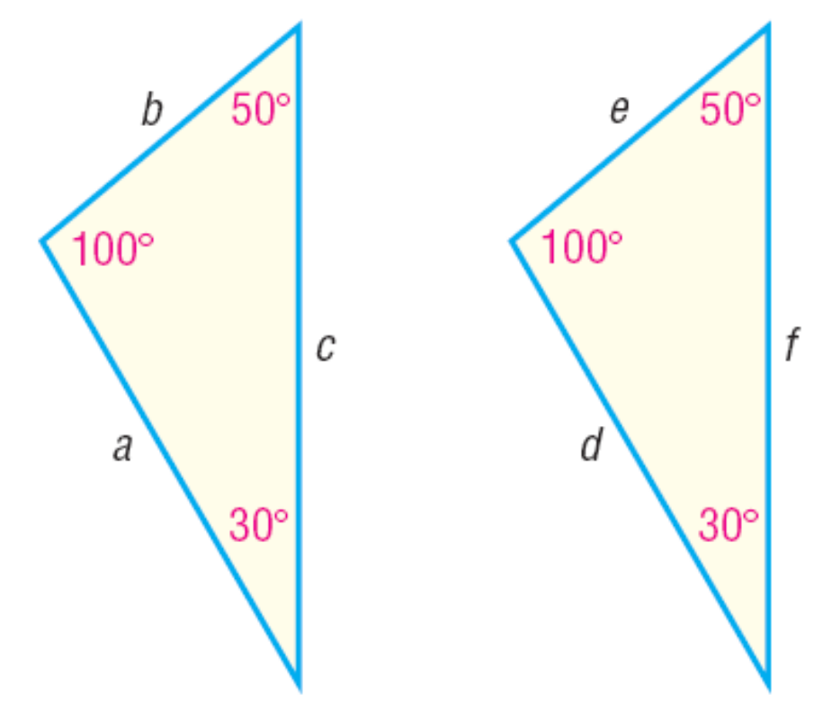

Copyright © 2012 Pearson Education, Inc. Publishing as Prentice Hall.

Slide 17
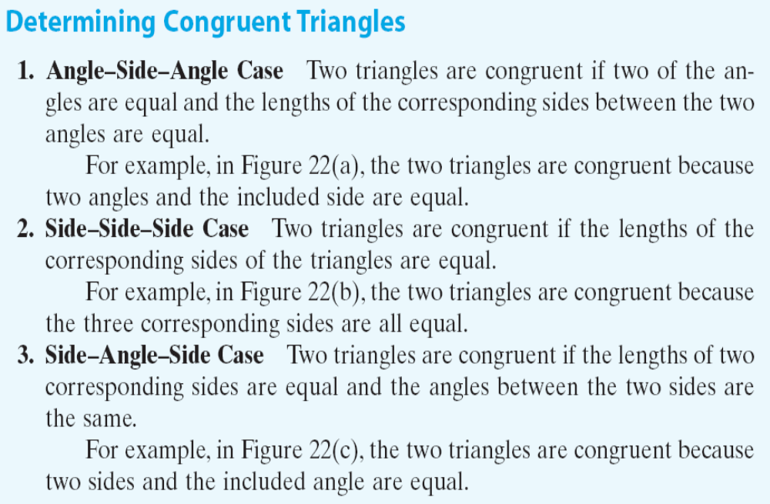
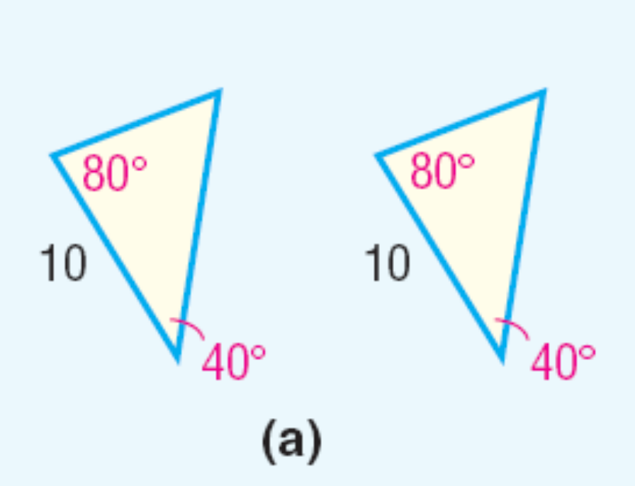
Copyright © 2012 Pearson Education, Inc. Publishing as Prentice Hall.

Slide 18
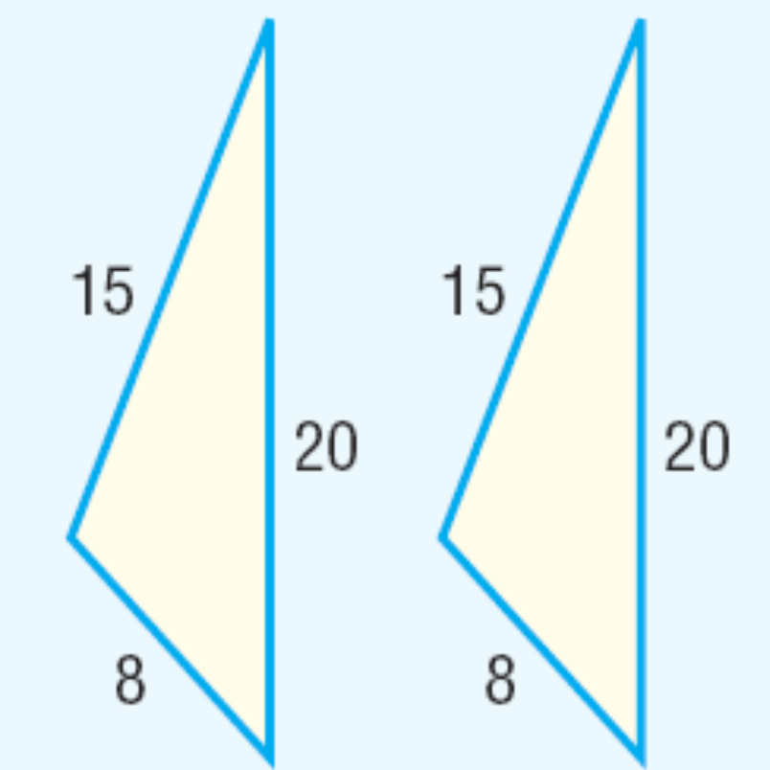
Copyright © 2012 Pearson Education, Inc. Publishing as Prentice Hall.

Slide 19
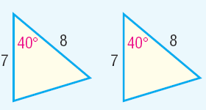
Copyright © 2012 Pearson Education, Inc. Publishing as Prentice Hall.

Slide 20


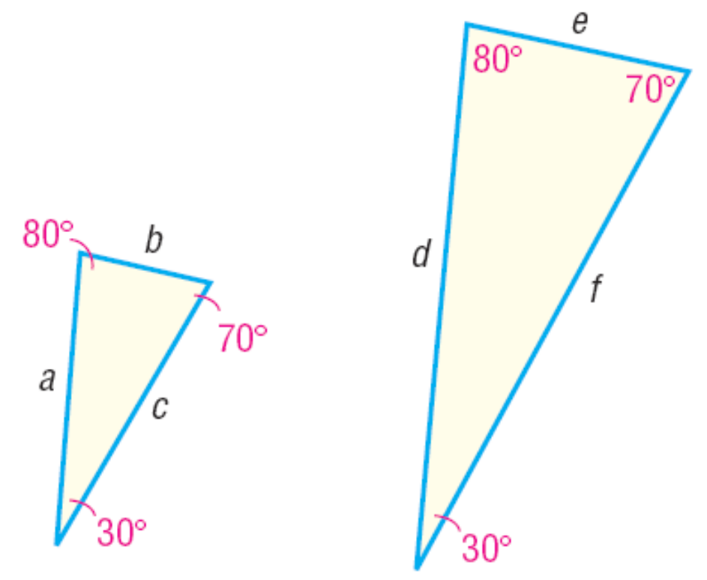
Copyright © 2012 Pearson Education, Inc. Publishing as Prentice Hall.

Slide 21
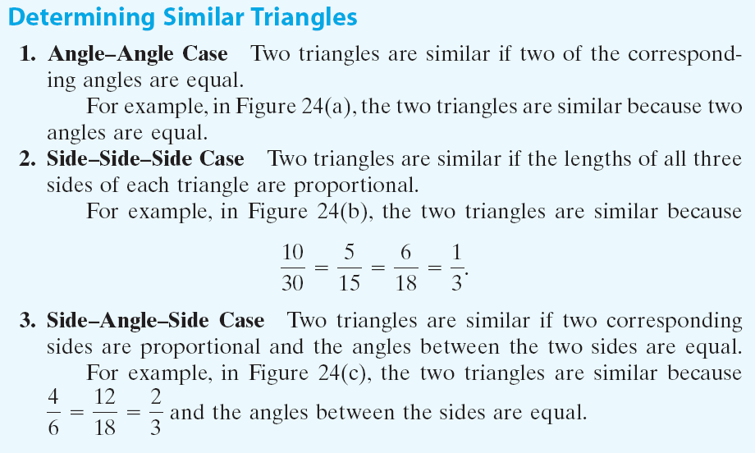
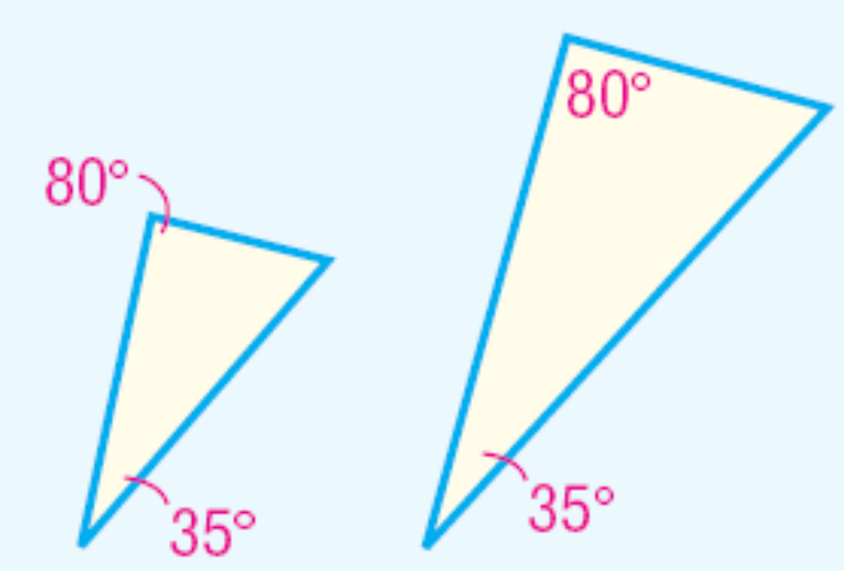
Copyright © 2012 Pearson Education, Inc. Publishing as Prentice Hall.

Slide 22
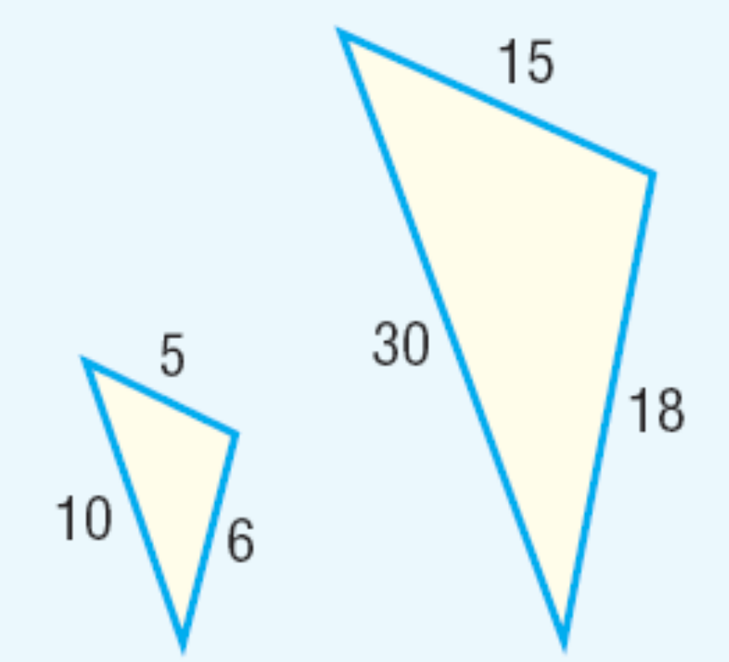

Copyright © 2012 Pearson Education, Inc. Publishing as Prentice Hall.

Slide 23
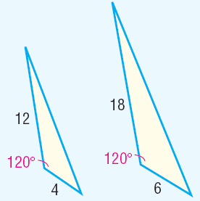

Copyright © 2012 Pearson Education, Inc. Publishing as Prentice Hall.

Slide 24

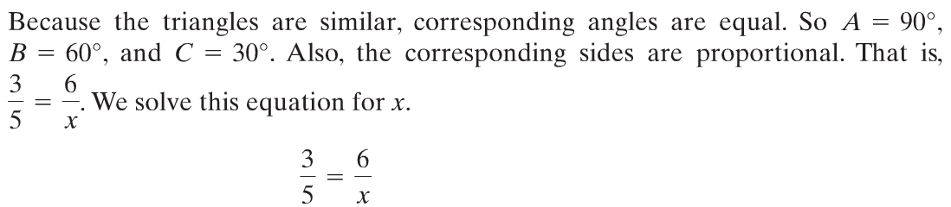




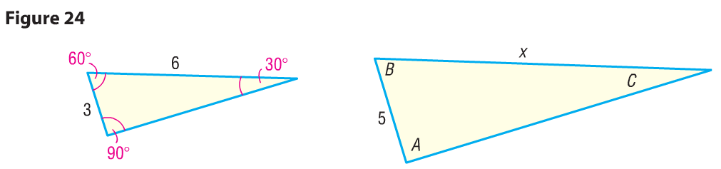
Copyright © 2012 Pearson Education, Inc. Publishing as Prentice Hall.

Slide 25
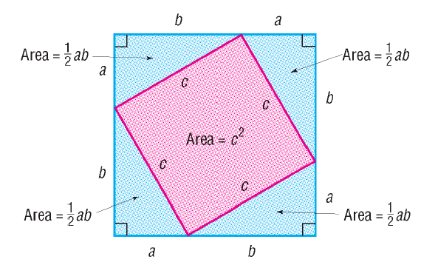
Copyright © 2012 Pearson Education, Inc. Publishing as Prentice Hall.

